Slide 1
CS 401 – ARTIFICIAL INTELLIGENCE
LECTURE: SEARCHING

Slide 2
Uninformed search strategies
Blind search
Problem definition
How are strategies different?
Difference between uninformed and informed?

Slide 3
BFS
Always implemented using queue
Concept of FIFO
Is it complete?
Is it optimal?
Time and space complexity O(b^{d+1})

Slide 4
BFS maze example
Is it possible to solve maze using bfs?
How?

Slide 5
DFS
Can be implemented using stack
Concept of LIFO

Slide 6
Properties
Is it complete?
Is it optimal?
Time complexity O(b^{m})
Space complexity O(bm)

Slide 7
Backtracking search
A variant of dfs
Space complexity O(m)

Slide 8
Depth limited search
DFS fails in infinite space or redundant paths
Provide DFS with a limit
Incomplete if limit< d
Not optimal if limit>d

Slide 9
Uniform cost search
algorithm that is optimal with any step-cost function
Problem?
Time and space complexity O(b^{(1+C/e)})

Slide 10
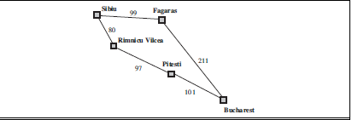

Slide 11
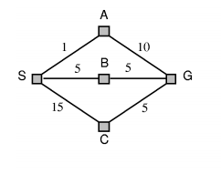
Travel from s to g (uniform cost search example)

